Slide 1
West Nile Virus
Control Recommendations To the City of Chicago

Slide 2
Overview
West Nile virus was first detected in the US in New York in 1999
A seasonal epidemic that can affect all of the US
3 million people in the US were infected by West Nile virus from 1999-2010
About 1 in 5 develops fever and other symptoms, while 1 in 150 develops potentially fatal health problems include encephalitis and meningitis
Most vulnerable populations include seniors and children with challenged immunities
Average of $56 million a year in health care costs and lost productivity
Human trials of subjects aged 50-65 were begun in 2015, but there is currently no vaccine
Notes:
Christopher will present first section

Slide 3
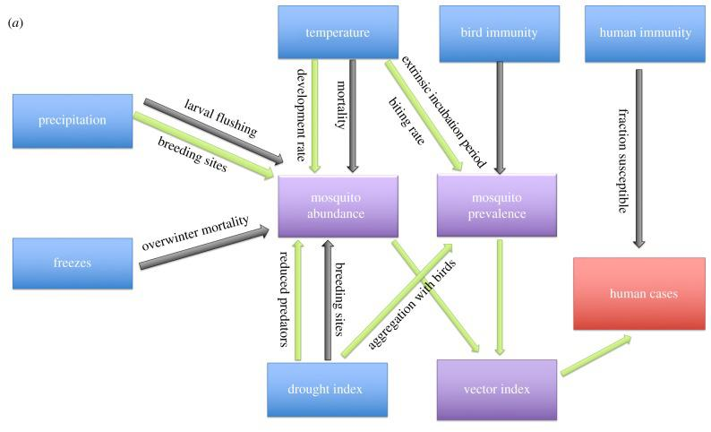
Factors that Influence Spread of WNV
Temperature and precipitation
Mosquito prevalence and abundance
Vector of disease in mosquitoes
Bird and human immunity

Slide 4
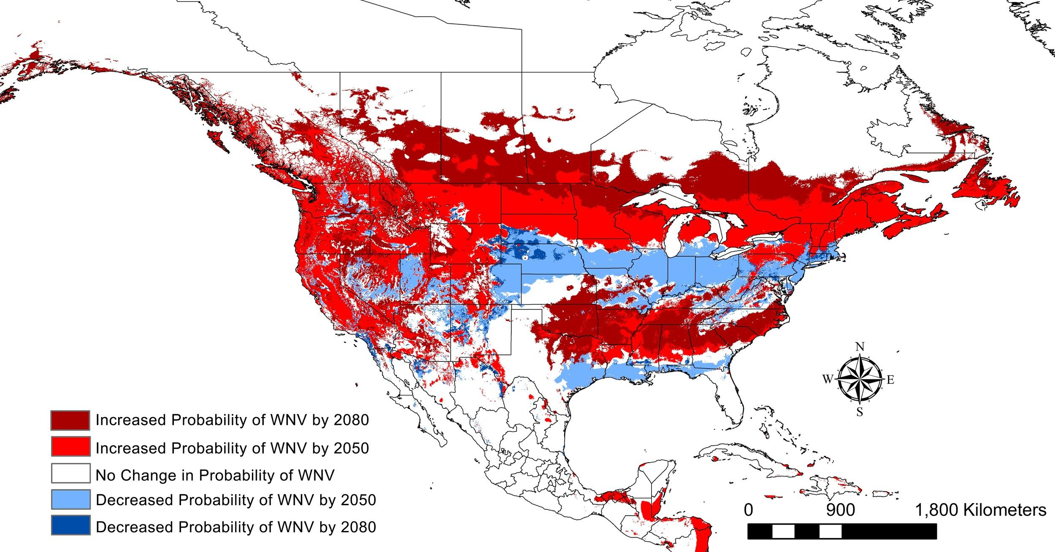
Climate change impact on spread of WNV
“... over the next 30 years, increased drought severity from climate change could triple West Nile virus cases, but only in regions with low human immunity.”
- Drought and immunity determine the intensity of West Nile virus epidemics and climate change impacts, Proceedings of the Royal Society B: Biological Sciences Proc Biol Sci. 2017 Feb 8; 284(1848): 20162078.

Slide 5
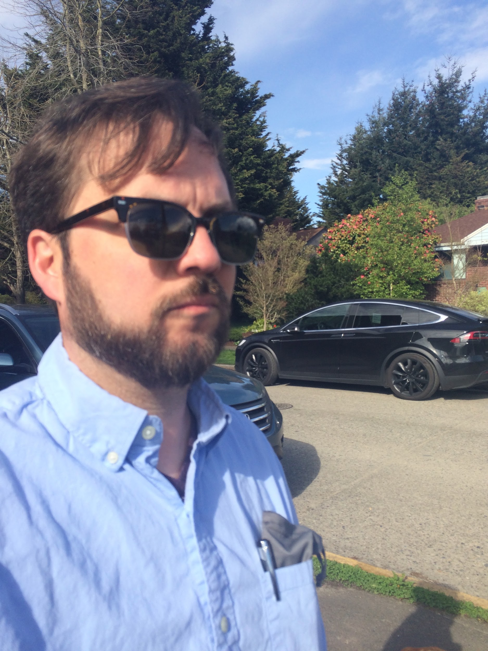
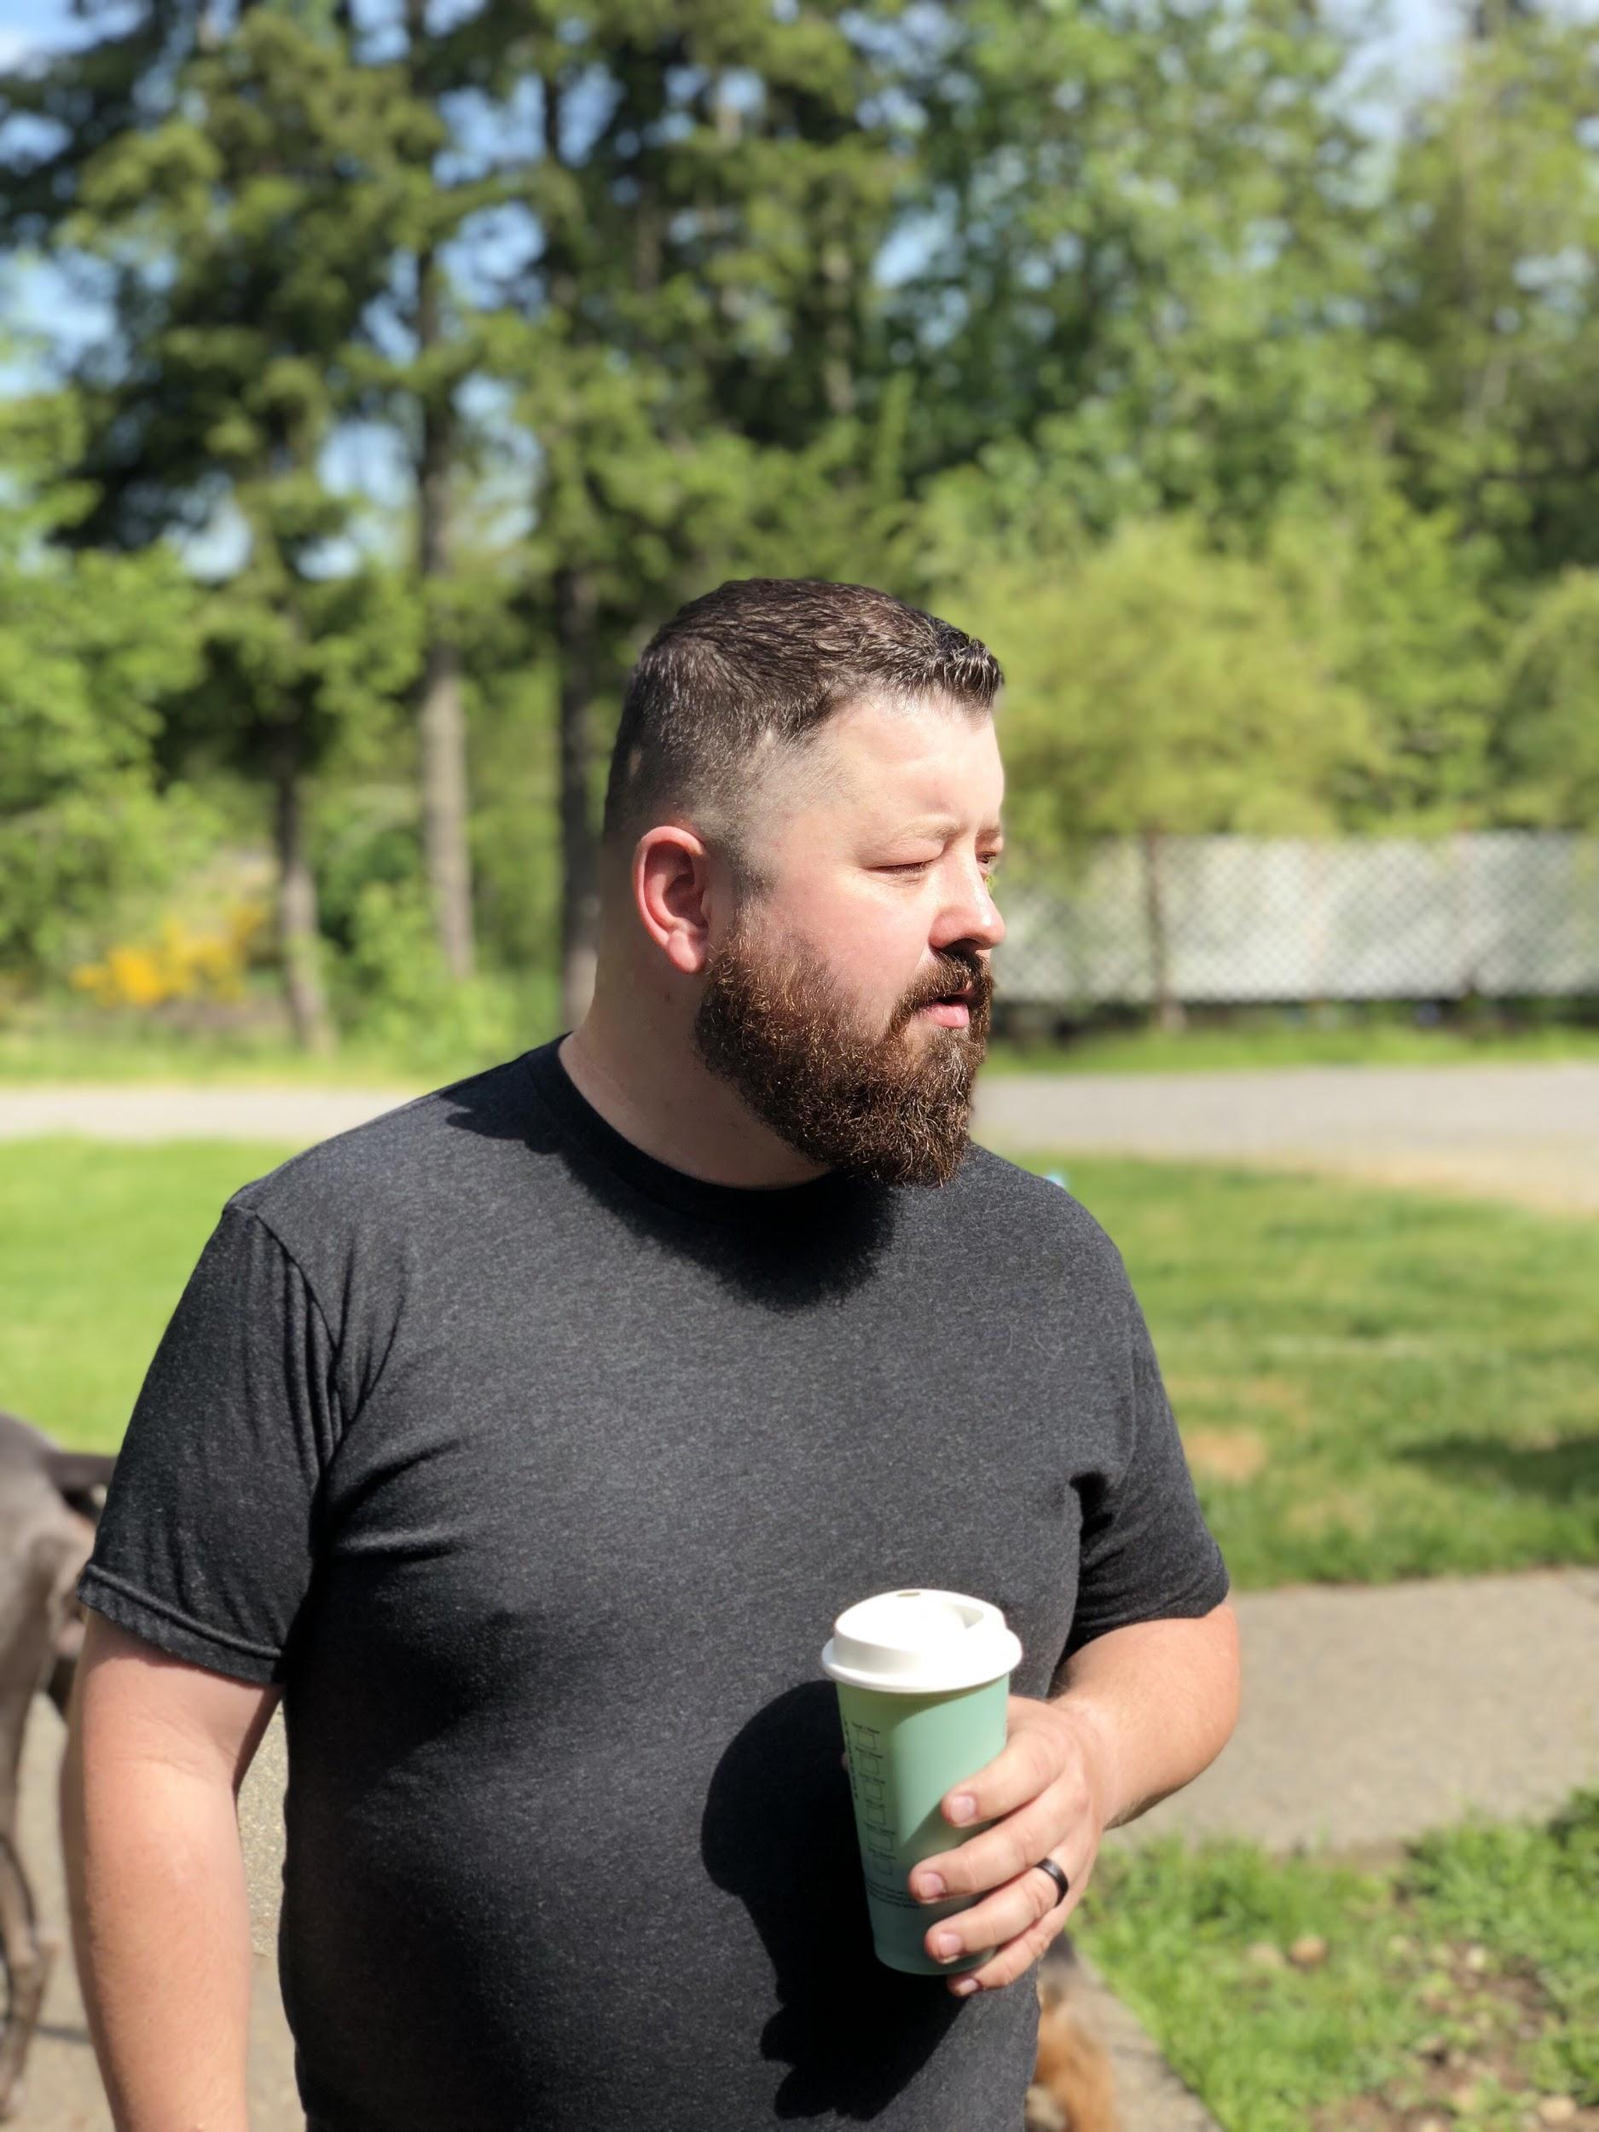
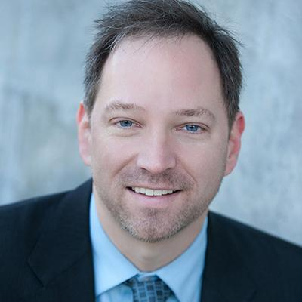
Team
To address this challenge, our team took on separate areas of responsibility, and used GitHub’s project management tool to coordinate.
GREG DAMICO
exploratory data analysis
modeling
presentation
DJ PORTER
modeling
presentation
CHRISTOPHER SHAININ
project management
presentation

Slide 6
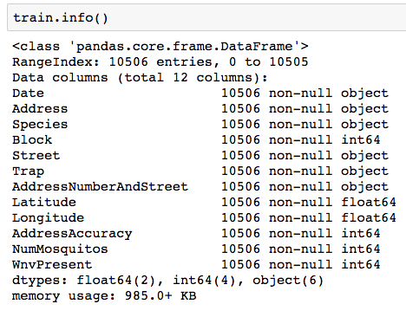
Modeling
Exploratory data analysis
Notes:
DJ Porter will cover

Slide 7
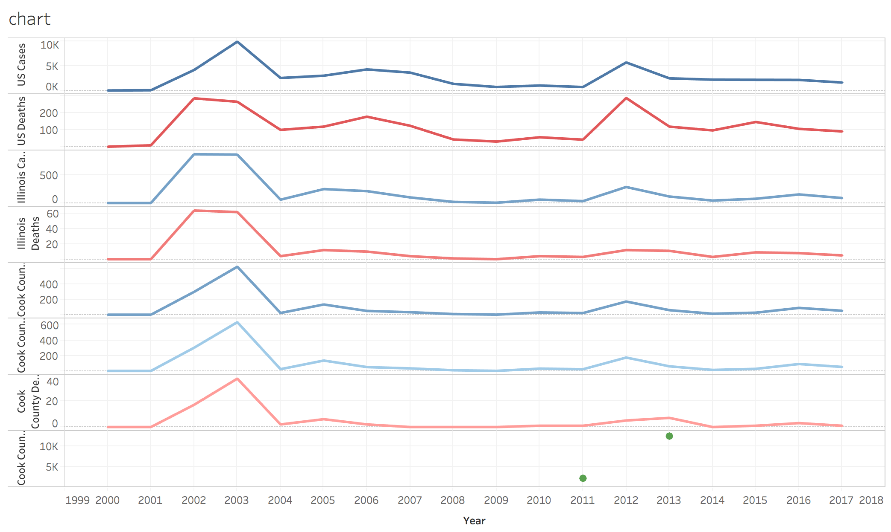
West Nile cases/deaths
US, Illinois, and Cook County
Significant increase in spraying in response to 2012

Slide 8
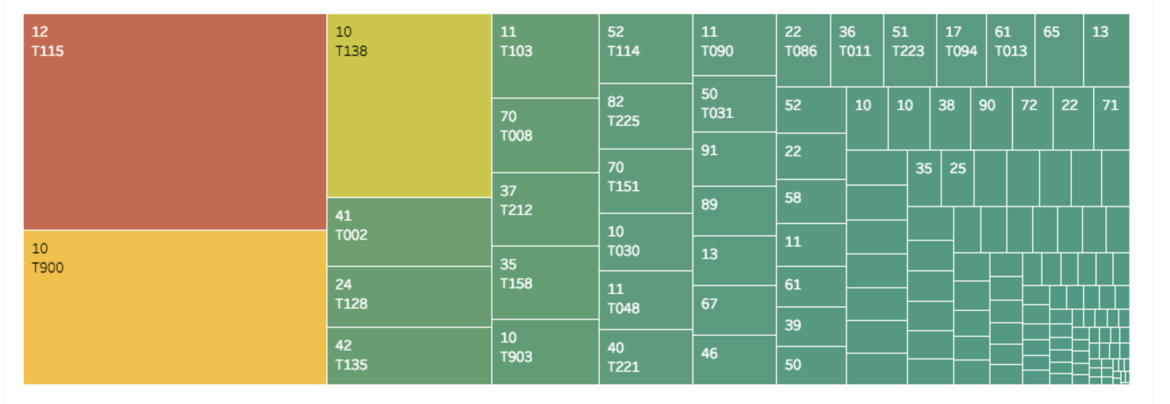
Block/trap sized by number of mosquitoes
- colored by scale
43,336
19,872
7,420
30,772
12
Notes:
Unproportionally distributed to certain areas

Slide 9
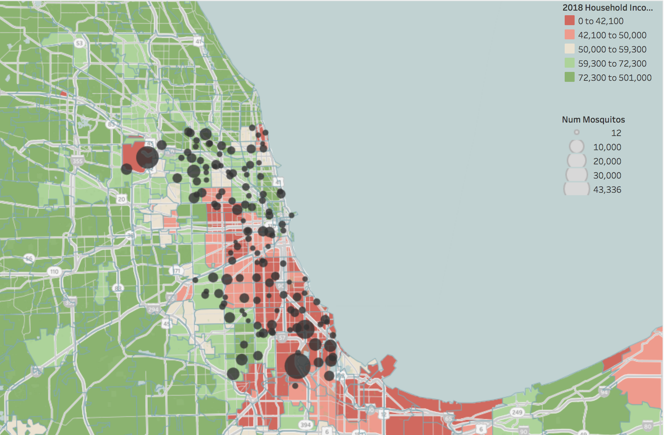
Mosquitoes affect vulnerable populations
City blocks with the highest number of mosquitoes trapped are ones with lowest household income

Slide 10
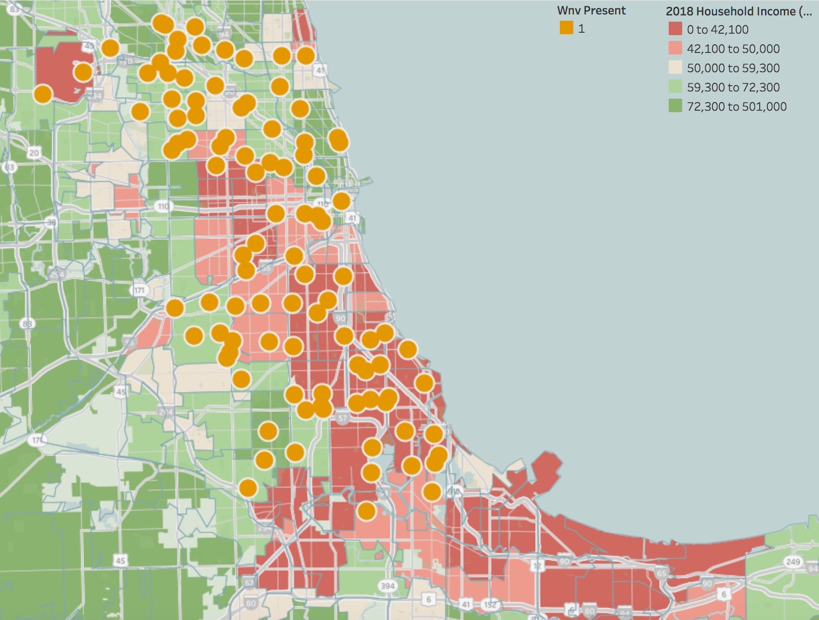
Mosquitoes with WNV in low income areas
Mosquitoes with WNV found in blocks with low household income

Slide 11
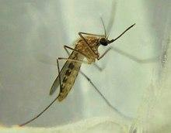
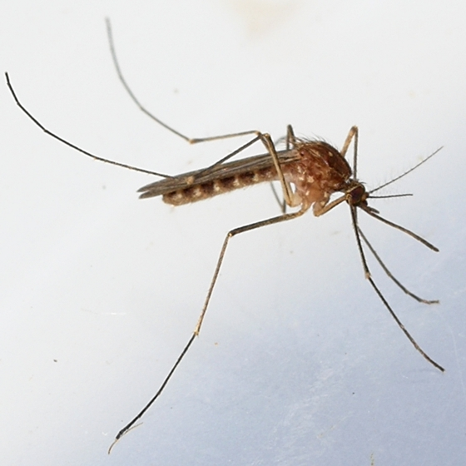
Six Species, Two Testing Positive for WNV
“About 70 percent of the positive samples have been from Culex pipiens (the house mosquito) and related species of Culex.” - Illinois Dept. of Public Health
Culex pipiens (wikipedia.org/wiki/Culex) | Culex restuans (https://bugguide.net/node/view/473403)
Notes:
Greg will cover

Slide 12
West Nile is Rare: Upsample!
West Nile was present in only 5.24% of cases.
Baseline accuracy: 94.76%
No positive predictions
Compensate for the class imbalance?
sklearn.utils.resample()

Slide 13
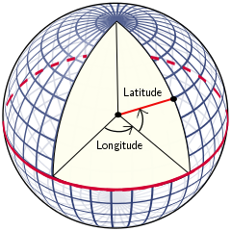
1° of Longitude ≠ 1° of Latitude!
To get an accurate measure of which weather
station (airport) is nearer, multiply the
longitude by cos(latitude in radians).
ord_lat = 41.995; ord_long = -87.933
mdw_lat = 41.786; mdw_long = -87.752
(https://vvvv.org/blog/polar-spherical-and-geographic-coordinates)

Slide 14
Bringing in Weather Data

Slide 15
Spray Data
Spraying was done in response to the results of the traps
Outbreak in 2012 → Major spraying campaign in 2013

Slide 16
Bringing in Spray Data
Strategy: Round latitude and longitude in both TRAIN and SPRAY
Look for intersections
How much to round?
1° of latitude is about 70 miles
Round to two decimal places

Slide 17
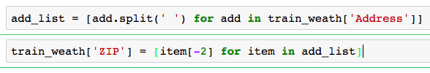
Isolating and Dummying ZIP Codes
Notes:
Problem here with ‘IL,’ showing up in the list. Is this perhaps connected with bad addresses / AddressAccuracy?
Some of these were fixed. Future work: Fixing all.

Slide 18
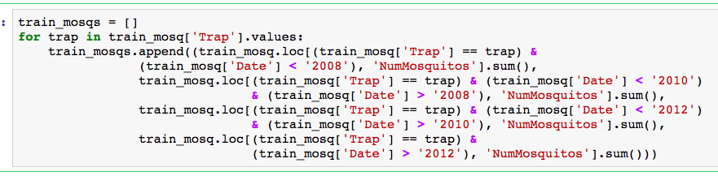
Adding NumMosquitos to Test
Step #1. Sort by trap, construct list of quadruples for mosquitos in (2007, 2009, 2011, 2013).

Slide 19
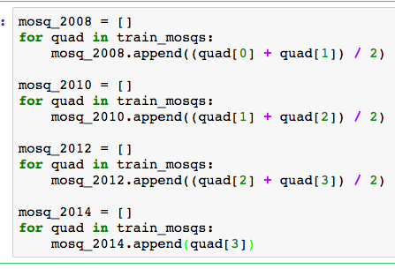
Adding NumMosquitos to Test
Step #2. Estimates:
2008: avg(2007, 2009)
2010: avg(2009, 2011)
2012: avg(2011, 2013)
2014: 2013

Slide 20
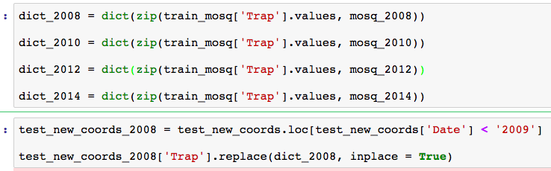
Adding NumMosquitos to Test
Steps ## 3-4: Construct dictionaries and use them to replace Trap values in test.
(Traps have already been dummied out.)

Slide 21

Modeling
Development and Testing
(paulvanderlaken.com)
Notes:
DJ will cover

Slide 22
Most Successful Models: Logistic Regressions and CNNs
Our most successful models were logistic regressions and convolutional neural networks, though we also tried
Random Forests
Extra Trees
Support Vector Machines

Slide 23
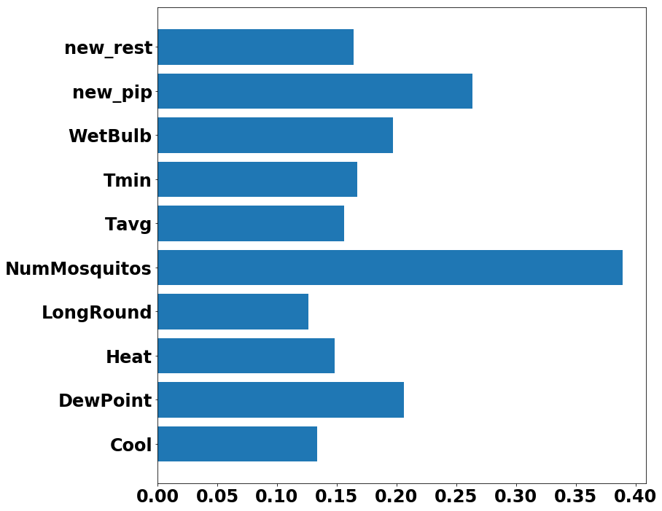
Pearson Correlation Coefficients
Notes:
New_rest, Heat, longround were negative

Slide 24
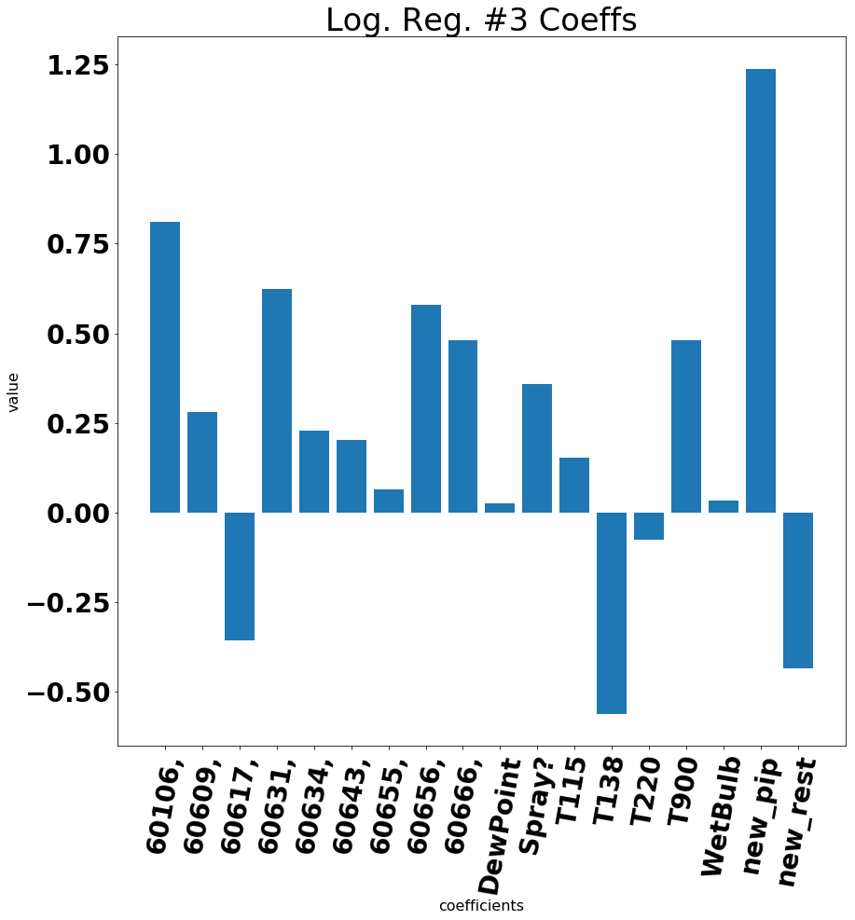
Logistic Regression Coefficients

Slide 25
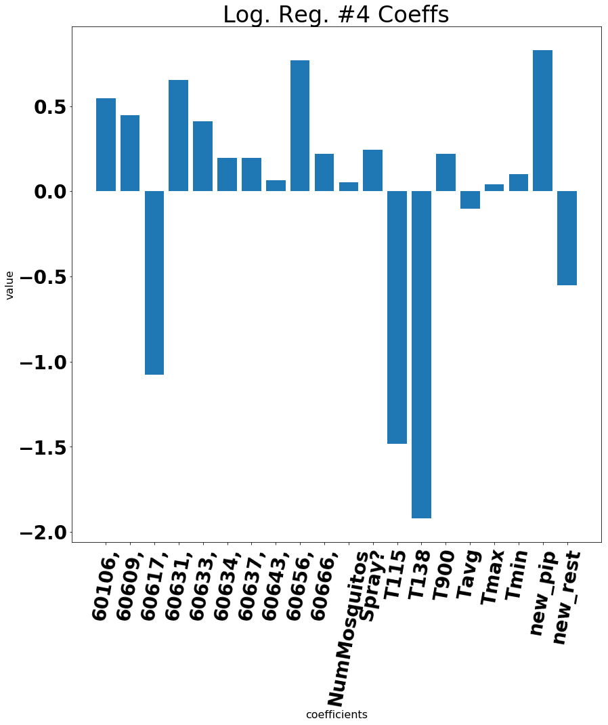
Logistic Regression Coefficients

Slide 26

Financial Analysis
Costs and Benefits of Spraying
(dreamstime.com)
Notes:
Christopher will cover

Slide 27
Cost benefit analysis: mosquitoes
Impact of disease on humans and animals
Lower quality of life due to annoyance
Negative impact on economy of outdoor recreation and work activities
Decrease in property values
$3 million
South Cook County Mosquito Abatement District

Slide 28
Cost benefit analysis: health costs
Sacramento County example
$2.28 million for medical treatment and productivity loss for both West Nile fever and West Nile neuroinvasive disease in 2005
Vector control cost $701,790 including spray procedures and overtime hours
Total economic impact was $2.98 million
Only 15 cases of West Nile neuroinvasive disease would need to be prevented to make spraying cost effective

Slide 29
Cost benefit analysis: health costs
Sacramento County example
$2.28 million for medical treatment and productivity loss for both West Nile fever and West Nile neuroinvasive disease in 2005
Vector control cost $701,790 including spray procedures and overtime hours
$2.98 million | 15
Total economic impact | Case would need to be prevented to make spraying cost effective.

Slide 30
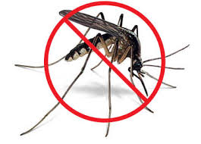
Recommendations
How to Proceed
(bixbyok.gov)
Notes:
Christopher will cover

Slide 31
Integrated Vector Management
CDC proposes IVM for vector control based on surveillance of mosquitoes while decreasing pesticide use
Includes resource allocation and education
Greatest control of mosquitoes when they are concentrated, immobile, and accessible

Slide 32
Treatment plan
Pesticides target life cycle of mosquito
BTi larval control
Ground based adult control fogging with Zenivex
Aerial adult control (naled) Dibtrom
Greatest control of mosquitoes when concentrated, immobile, and accessible
Studies have shown that impact of pesticides on vulnerable populations is modest compared to benefit

Slide 33
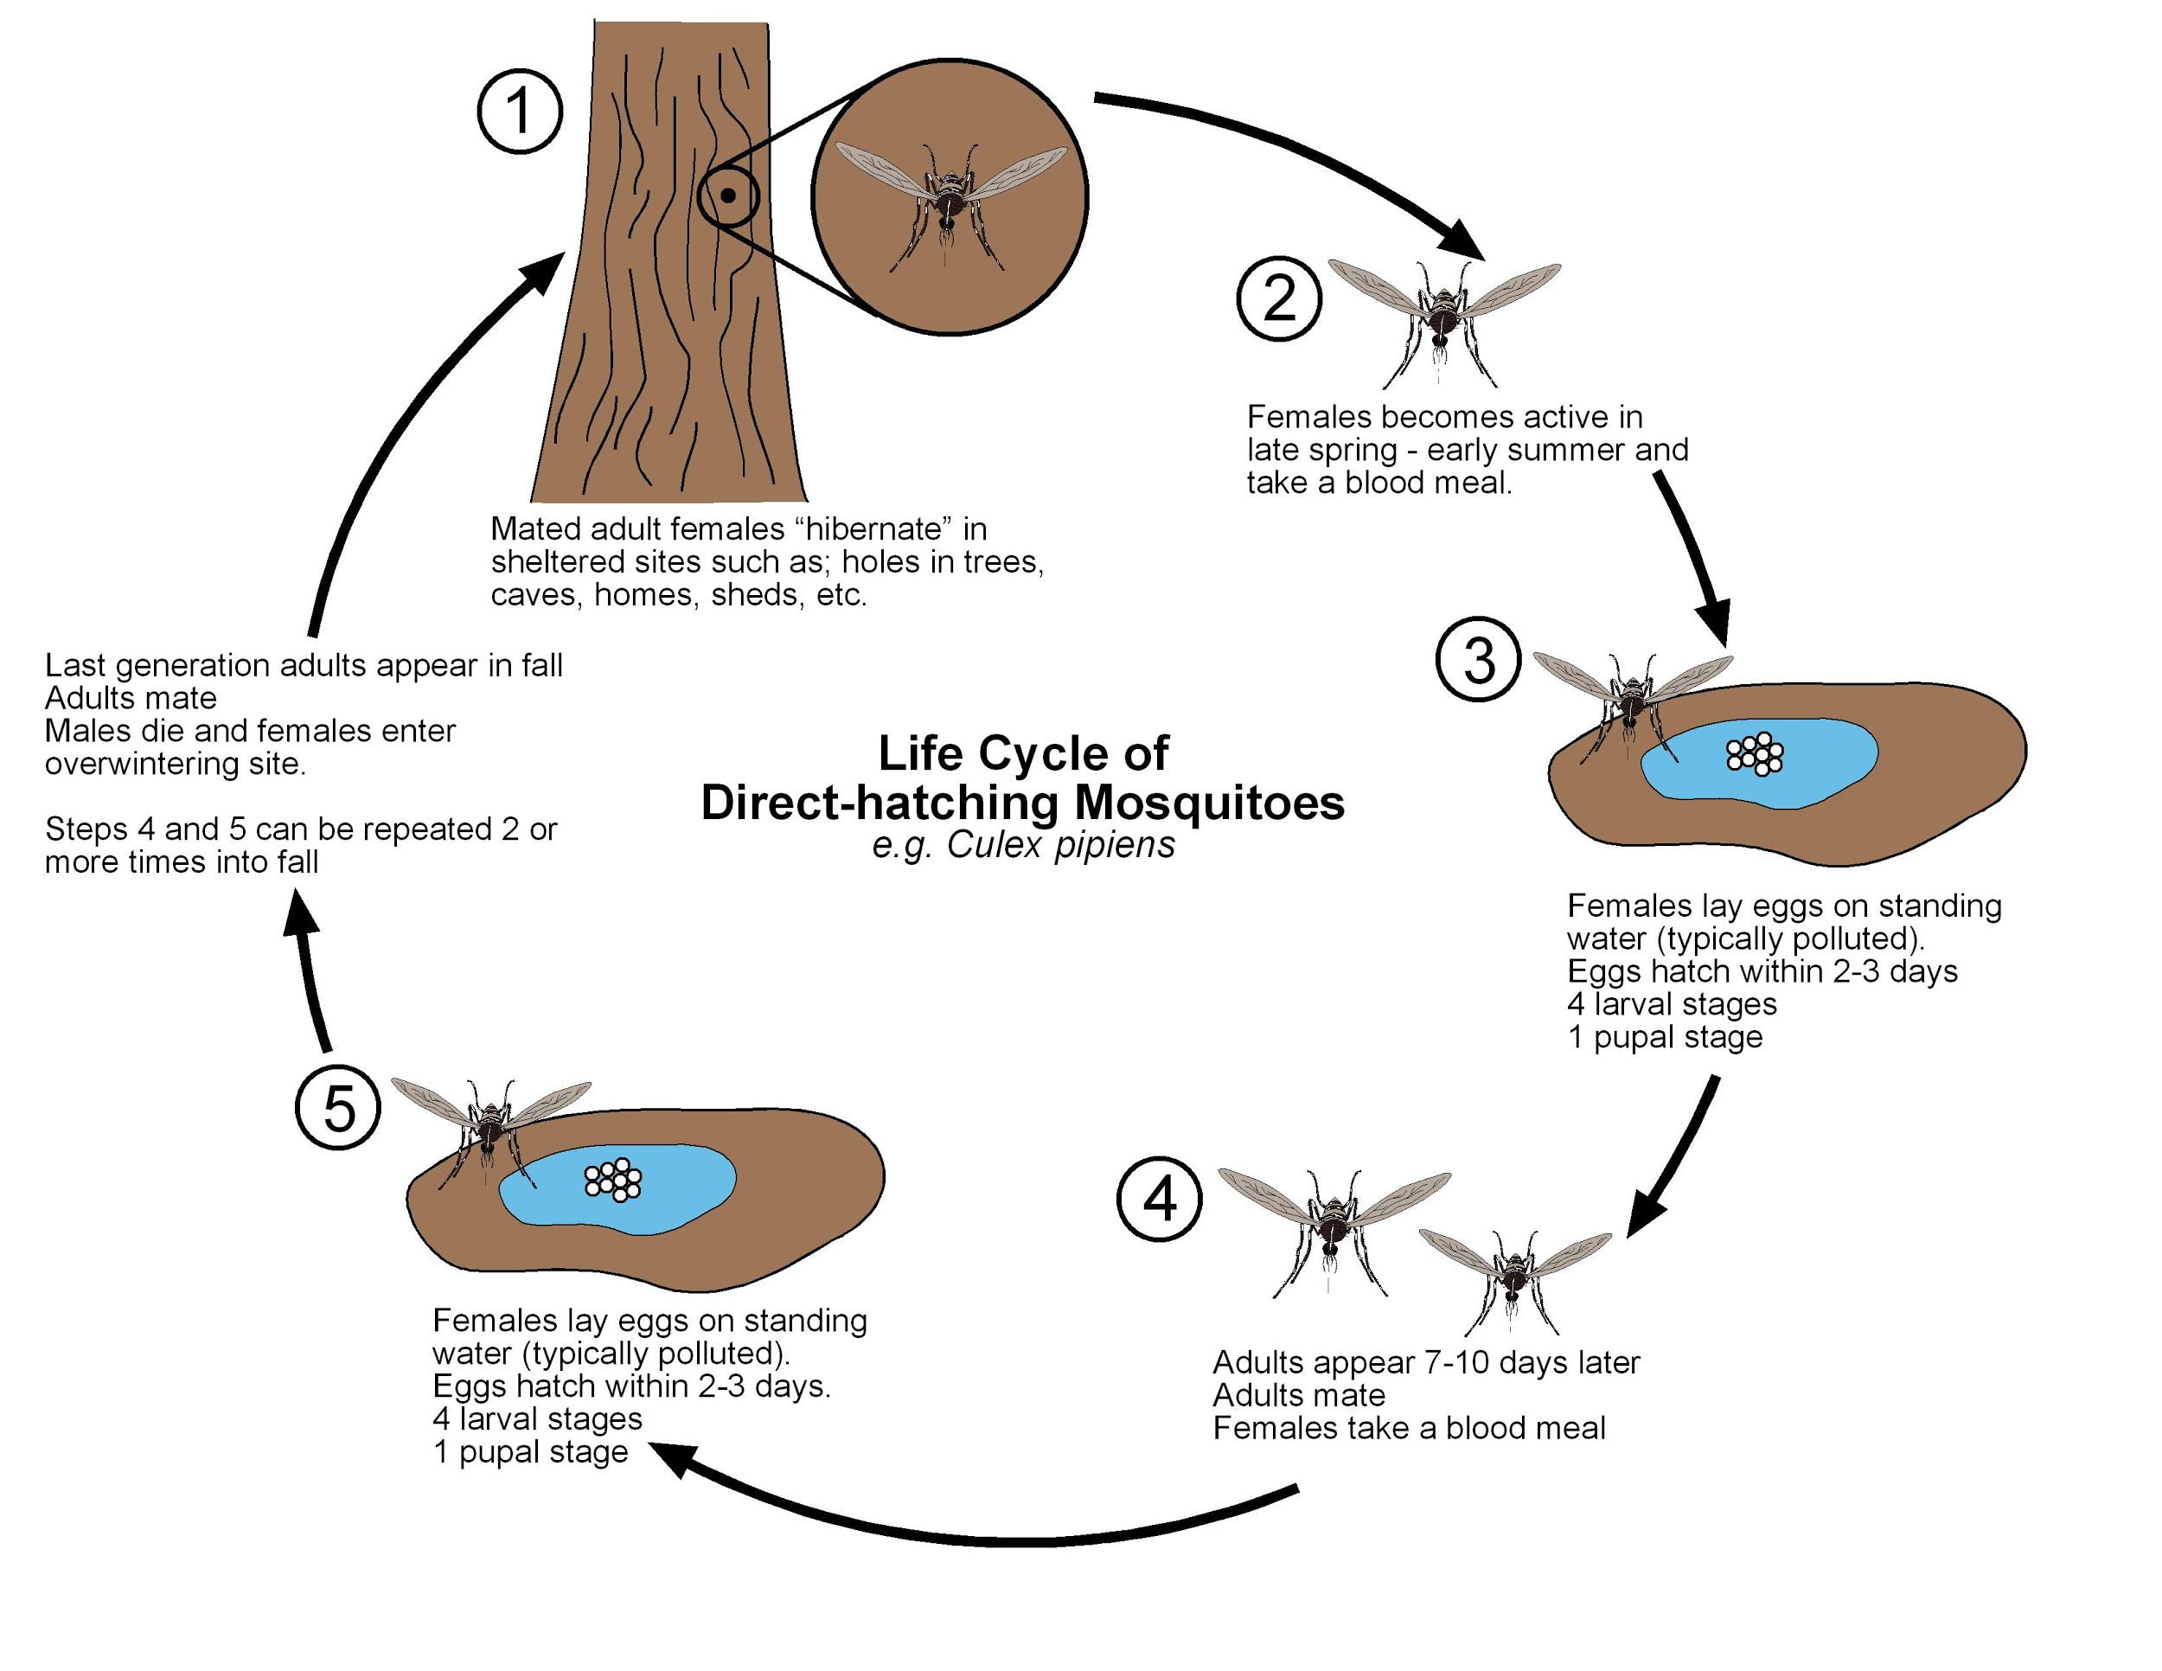
Treatment Schedule
Deploy larvicides after heavy rain
Season ends in October educate public to address hibernating mosquitoes
20XX
April (beginning of warm wet weather)
Street level fogging
Aerial spray of adulticides for outbreaks

Slide 34
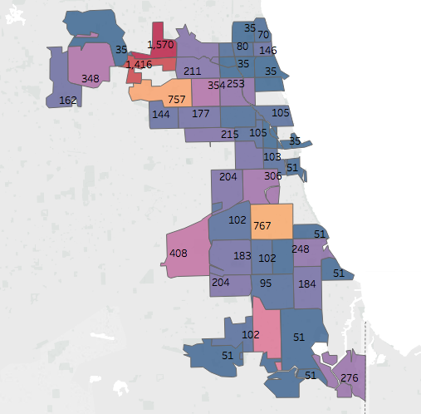
Predictions by
ZIP Code
Number of expected infected mosquitoes
ZIP 60631: 1570
ZIP 60656: 1416
ZIP 60609: 767
ZIP 60634: 757
Notes:
DJ and Greg

Slide 35
Mosquitoes with WNV found in low income areas
Highest impact areas are Normandy Park which is east of O’Hare Airport and portions of South Chicago. Both are low-income areas.
Mosquitoes with WNV found in blocks with low household income

Slide 36
Recommendations
Though there has been a decrease in WNV, Cook County should continue mosquito abatement funding at current levels to ensure against outbreaks
Focus on key zip codes for IVM including spraying and education
Maintain high levels of surveillance to guard against outbreaks
Invest in rapid response to combat outbreaks
Encourage local pest control companies to educate and provide services to combat mosquitoes for their customers.
Notes:
DJ will cover

Slide 37
Further Research
Since birds are the primary carrier of the West Nile Virus, it would make sense to study which bird species are primary carriers.
Determine how long to wait between spray applications to deploy pesticides most effectively
1
3
2
Want to know number of incidents of West Nile virus found in each mosquito trap
4
Interaction of pesticides and weather
5
Improving address acquisition technology
6
National trends
Notes:
Greg will cover
--getting more accurate addresses?
--national trends? →
www.cdc.gov/westnile/statsmaps/preliminarymapsdata2017/index.html

